Slide 1
Oracle and/or Hadoop And what you need to know…
Jean-Pierre Dijcks Data Warehouse Product Management

Slide 2
Agenda
Business Context
An overview of Hadoop and/or MapReduce
Choices, choices, choices…
Q&A
Notes:
2

Slide 3
Business Drivers Changing IT
More
More data
More users
More analysis
More uptime

Slide 4
Business Drivers Changing IT
More
Faster
Performance
Startup
Development
Time to Market

Slide 5
Business Drivers Changing IT
More
Faster
Hardware
Fewer Staff
Less Power
Less Cooling
Cheaper

Slide 6
Some Reactions to these Changes
Open Source Software
Grid Computing on Commodity Hardware
Virtualization
The emergence of the Cloud
Democratization of IT
Always-on Systems
Democratization of BI
Operational Data Warehousing
Vertical Solutions
Etc…
Notes:
6

Slide 7
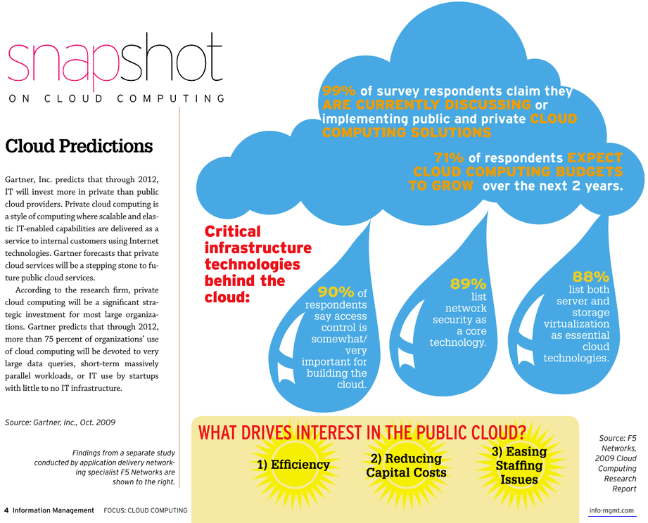
The Cloud
Very large queries
Massively parallel workloads
No IT required
Notes:
Information management magazine, Oct 2009

Slide 8
Some Contradictions
More Uptime
Open Source is cheap but less robust
Better Performance
Cloud and Virtualization are slower
Less Hardware
MPP Clusters (Hadoop) need more HW
Fewer Staff
Hadoop requires lots of programming
Choose wisely…
Notes:
8

Slide 9
What is Hadoop?
Notes:
9

Slide 10
Hadoop Architecture
Hadoop is a shared nothing compute architecture that:
Is open source (as opposed to Google’s implementation)
Is a data processing architecture
Processes data in parallel to achieve its performance
Processes on very large clusters (100 – 1000s of nodes) of cheap commodity hardware
Automatically deals with node failures and redeploys data and programs as needed
Some say is it very cool…
Cloud ≠ Hadoop – Hadoop can run in a (private) cloud…
Notes:
10

Slide 11
High-level Hadoop Architecture
Components:
Hadoop client is your terminal into the Hadoop cluster
Initiates processing, no actual code is run here
NameNode manages the metadata and access control
Single node, often redundant with exactly one secondary namenode
JobTracker hands out the tasks to slaves (query coordinator)
Slaves are called TaskTrackers
Data Nodes store data and do the processing
Data is redundantly stored across these data nodes
Hadoop Distributed File System (HDFS) stores input and output data
Notes:
11
For some more information see: http://www.cs.brandeis.edu/~cs147a/lab/hadoop-cluster/
Hadoop DFS (HDFS) is an open source distributed file system implementation from the Apache Software Foundation. HDFS is designed to run on clusters of nodes built from low-cost hardware. It is not uncommon for the clustered nodes to number in the dozens or hundreds --and sometimes thousands. An HDFS file is chopped into blocks (usually 64 MB), each of which is replicated multiple times across the nodes in the HDFS system for fault-tolerance and performance. HDFS is increasingly being used by companies to store large amounts of data, especially by Dot.Com companies with enormous server farms.

Slide 12
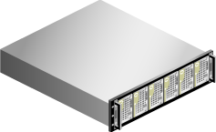
A typical HDFS cluster
Download periodic checkpoints
Clients or programs communicate with namenode about location of data (where to read from and write to)
Client / Program
Passive secondary NameNode (no automatic failover)
NameNode
Holds metadata about where data lives
Query Coordinator
Direct interaction with datanodes for reading and writing of data to the nodes
Hold active and passive data
JobTracker
DataNodes / TaskTrackers

Slide 13
Loading Data (simplified)
Client / Program
NameNode
1
Request data placement
2
Receive data placement info
Buffer Data
4
Confirmation on both writes
DataNodes
3
Write data chunk to both primary and secondary node of the cluster

Slide 14
Querying Data (simplified)
NameNode
Holds metadata about where data lives
Client / Program
Data Location
Aggregated Results
Aggregate results
JobTracker
Parcels out assignments and aggregates results
DataNodes / TaskTrackers
Execute mappers and reducers

Slide 15
What is the typical use case?
The common use cases cited are things like:
Generating inverted indexes (Text Searching)
Non-relational data (Log files, web click etc.) analysis on extreme volumes
Some types of ETL processing
What it does not do:
No database (neither relational nor columnar nor OLAP)
Not good at real time or short running jobs
Not deal well with real time or even frequent/regular updates to the data on the cluster
Not very easy to use (developers only please) as it is pure coding and debugging (look at things like Cascading etc…)
Notes:
15

Slide 16
MapReduce Programs
MapReduce is a software framework introduced by Google to support distributed computing on large data sets on clusters of computers.[
MapReduce is:
The program building blocks for an Hadoop cluster
Reducers consume data provided by mappers
Many mappers and reducers are running in parallel
Written in many languages (Perl, Python, Java etc)
Notes:
16

Slide 17
MapReduce Example
A very common example to illustrate MapReduce is a word count…
In a chunk of text count all the occurrences of a word, either specific words or all words
This functionality is written in a program executed on the cluster delivering a name value pair with a total word count as the result
Notes:
http://en.wikipedia.org/wiki/MapReduce

Slide 18
MapReduce Example
Input Reader
The cloud is water vapor. But is water vapor useful? But it is!
Map process
Map process
the, 1 cloud, 1 is, 1 water, 1 vapor, 1 but, 1 is, 1
water, 1 vapor, 1 useful, 1 but, 1 it, 1 is, 1
Partition, Compare, Redistribute
the, 1 cloud, 1 is, 1 is, 1 is, 1 but, 1 but, 1
Water,1 vapor, 1 water, 1 vapor, 1 it, 1 useful, 1
http://en.wikipedia.org/wiki/MapReduce
Notes:
http://en.wikipedia.org/wiki/MapReduce

Slide 19
MapReduce Example
the, 1 cloud, 1 is, 1 is, 1 is, 1 but, 1 but, 1
water,1 vapor, 1 water, 1 vapor, 1 it, 1 useful, 1
Reducer
Reducer
the, 1 cloud, 1 is, 3 but, 2
water, 2 vapor, 2 it, 1 useful, 1
the, 1 cloud, 1 water, 2 is, 3 but, 2 vapor, 2 it, 1 useful, 1
Consolidate and Write
Notes:
http://en.wikipedia.org/wiki/MapReduce

Slide 20
…In the eye of the Beholder
There is a lot of confusion about what Hadoop is or does in detail so, when Hadoop comes up there is a mismatch between the perceived capabilities and the real capabilities:
Hadoop is talked about as a simple solution
Hadoop is talked about as being low cost
A data warehouse has a lot of data so Hadoop should work
Massively parallel capabilities will solve my performance problems
Everyone uses Hadoop
Notes:
20

Slide 21
Myths and Realities
Hadoop is talked about as a simple solution
But you need expert programmers to make anything work
It is Do It Yourself parallel computing (no optimizer, no stats, no smarts)
Only works in a development environment with few developers and a small set of known problems
Hadoop is talked about as being low cost
Yes, it is open source with all its pros and cons
And don’t forget the cost of a savvy developer or six…
A data warehouse has a lot of data so Hadoop should work
Maybe, but probably not. Hadoop does not deal well with continues updates, ad-hoc queries, many concurrent users or BI Tools
Only programmers can get real value out of Hadoop, not your average business analyst
Notes:
21

Slide 22
Myths and Realities
Massively Parallel Processing will solve my performance problems
Well… maybe or maybe not
The appeal of Hadoop is the ease of scaling to thousands of node not raw performance
In fact benchmarks have shown a relational DB to be faster than Hadoop
Not all problems benefit from the capabilities of the Hadoop system; Hadoop does solve some problems for some companies
Everyone uses Hadoop
Well, mostly the internet focused business, and maybe a few hundred all in all
And yes, they use it for specific static workloads like reverse indexing (internet search engines) and pre-processing of data
And do you have the programmers in-house that they have?
Notes:
22
Benchmark between Hadoop and Shared Nothing Databases: http://database.cs.brown.edu/sigmod09/benchmarks-sigmod09.pdf

Slide 23
Myths and Realities
But…
If you have the programmers / knowledge
If you have the large cluster (or can live with a cloud solution)
You can create a very beneficial solution to a Big Data problem as part of your infrastructure
Notes:
23

Slide 24
Oracle and/or Hadoop
Run MapReduce within an Oracle Database is very easy
Using Hadoop and then feeding the data to Oracle for further analysis is more common and quite easy
Integrating (e.g. a single driving site) leveraging both frameworks is doable but more involved…
Notes:
24

Slide 25
Using Oracle instead of Hadoop Running MapReduce within the Database
Oracle Database 11g
Table
Table
Reduce
Map
Reduce
Map
Code…
Notes:
25

Slide 26
Using Oracle instead of Hadoop Running MapReduce within the Database
HDFS
Oracle Database 11g
Datafile_part_1
HDFS
External Table
Table
Datafile_part_2
Fuse
HDFS
Datafile_part_m
HDFS
Datafile_part_n
Map
Reduce
HDFS
Datafile_part_x
Notes:
26

Slide 27
Using Oracle Next to Hadoop RDBMS is a Target for Hadoop Processing
HDFS
Output_part_1
Oracle Database 11g
HDFS
Output_part_2
Join, filter, transform data using Oracle DB
Fuse
HDFS
Output_part_m
HDFS
Output_part_n
External Table
HDFS
Output_part_x
Notes:
27

Slide 28
Running Oracle with Hadoop Integrated Solution
HDFS
Oracle Database 11g
Output_part_1
Processing data using Table Functions after producing results in Hadoop
Results
HDFS
Output_part_2
Results
Process
Process
Process
Queue
Results
HDFS
Output_part_m
Results
HDFS
Read
Output_part_n
Results
Namenode
Controller Table Function directing Hadoop jobs
Metadata
Notes:
28

Slide 29
Starting the Processing
Table
1
Job Monitor
Launcher
Hadoop Mappers
Table Function Invocations
Asynchronous
3
Synchronous
4
2
QC
6
Queue
En-queue
5
De-queue
Notes:
29

Slide 30
Monitoring the Hadoop Side
Job Monitor
Launcher
Hadoop Mappers
Table Function Invocations
Asynchronous
Synchronous
7
8
6
Queue
De-queue
Notes:
30

Slide 31
Processing Stops
Job Monitor
Table Function Invocations
Asynchronous
9
Queue
Notes:
31

Slide 32
Do you need Hadoop? Some Considerations
Think about the data volume you need to work with
What kind of data are you working with
Structured?
Un/semi structured?
Think about the application of that data (e.g. what workload are you running)
Who is the audience?
Do you need to safeguard every bit of this information?
Notes:
32

Slide 33
Size Matters
Source: TDWI Next Generation Data Warehouse Platforms Report, 2009

Slide 34
Size Matters
Source: TDWI Next Generation Data Warehouse Platforms Report, 2009

Slide 35
Workload Matters
Source: TDWI Next Generation Data Warehouse Platforms Report, 2009

Slide 36
Do you need Hadoop – Part 1 Yes, as a Data Processing Engine
If you have a lot (couple of 100TBs) of unstructured data to sift through, you probably should investigate it as a processing engine
If you have very processing intensive workloads on large data volumes
Run those “ETL like” processes every so often on new data
Process that data and load the valuable outputs into an RDBMS
Use the RDBMS to share the results combined with other data with the users
Notes:
36

Slide 37
Do you need Hadoop – Part 1 Yes, as a Data Processing Engine
HDFS
Output_part_1
Oracle Database 11g
HDFS
Output_part_2
Join, filter, transform data using Oracle DB
Fuse
HDFS
Output_part_m
HDFS
Output_part_n
External Table
HDFS
Data Processing Stage
Data Warehousing Stage
Notes:
37

Slide 38
Do you need Hadoop – Part 2 Not really…
Overall size is somewhere around 1 – 10TB
Your data loads are done with flat files
You need to pre-process those files before loading them
The aggregate size of these files is manageable:
Your current PERL scripts work well
You do not see bottlenecks in processing the data
The work you are doing is relatively simple
Basic string manipulations
Some re-coding
Notes:
38

Slide 39
Conclusion Design a Solution for YOUR Problem
Understand your needs and your target audience
Choose the appropriate solution for the problem
Don’t get pigeonholed into a single train of thought
Notes:
39

Slide 40
Need More Information?
Read this (or just Google around):
http://Hadoop.apache.org
http://database.cs.brown.edu/sigmod09/benchmarks-sigmod09.pdf
http://www.cs.brandeis.edu/~cs147a/lab/hadoop-cluster/
http://blogs.oracle.com/datawarehousing/2010/01/integrating_hadoop_data_with_o.html
http://blogs.oracle.com/datawarehousing/2009/10/in-database_map-reduce.html
Notes:
40

Slide 41
Questions
Notes:
41

