Slide 1
DBA’s Guide to Physical Dataguard
Ahbaid Gaffoor – Amazon.com/A9
ahbaid@{amazon.com|a9.com|att.net}
NoCOUG.org : Feb 12th 2009

Slide 2
Overview:
Slides
Intended Audience
Standby Database
Logical Standby (Brief)
Physical Standby
Dataguard
Overview / Components
Listener Configuration
TNS Configuration
Database Configuration
Monitoring
RMAN Integration
Production Tips
VMware Setup & Recommendations
Demo
VMware Setup
Physical Standby
Manual Recovery
Ship and Apply
Dataguard
Listener & TNS Config.
Database Config.
Switchover & Failover
Operations
Log switches
Datafile Mgmt.
Anything else…

Slide 3
Intended Audience:
Beginner’s Guide
No advanced topics:
Broker
Fast Start Fail Over
DGMGRL
RAC Standby
Plan to cover:
Physical Standby
Dataguard:
MAXIMUM PERFORMANCE
MAXIMUM AVAILABILITY
MAXIMUM PROTECTION

Slide 4
Standby Database
Redo
Archive Logs
Transport
Manual Recovery
Manual Switch/Fail Over
Archive Logs
DB
a₁
apply
a₂
STANDBY DB
Redo logs
Archive Logs
r₁
a₁
DB
r₂
a₂
TRANSPORT
scp, ftp, nfs
arc0
r₃
a₃
lgwr
r₄
PRIMARY DB

Slide 5
Logical Standby
READER
PREPARER
BUILDER
COORDINATOR
SQL Apply
Not all SQL
Archive Logs
DB
a₁
a₂
READER
PREPARER
SQL Apply
BUILDER
LCR
cache
COORDINATOR
STANDBY DB

Slide 6
Dataguard::Overview
Physical Standby
Manual Transport
Manual Apply
Disconnected
Manual Switch/Fail over
Dataguard
Oracle Transport
ARCH
LGWR
Automatic Apply
Connected
Broker
FSFO
Faster Switch/Fail over
Protection Levels
MAX PERFORMANCE
MAX AVAILABILITY
MAX PROTECTION

Slide 7
VMware::Overview
VMware Server 1.0.8
Vmware Server 2.0.0
DataStore – Directory
Create / Import VM in DataStore
Use an Administrator account
Web based: localhost 8222 and 8333 (SSL)
Setup
Host OS: XP Pro 32-bit SP3, 64-bit Vista SP1
Guest OS: Oracle Enterprise Linux 5 32-bit
Host: localhost
Guest Machines: tintin and haddock
Database: snowy, Oracle 10.2.0.4 32-bit

Slide 8
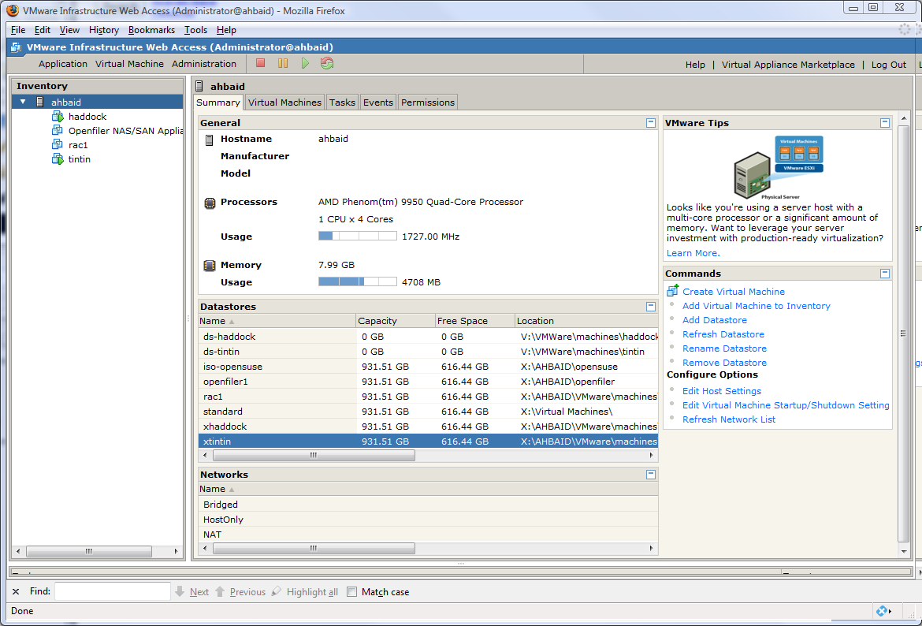
Vmware::VMware 2 Console

Slide 9
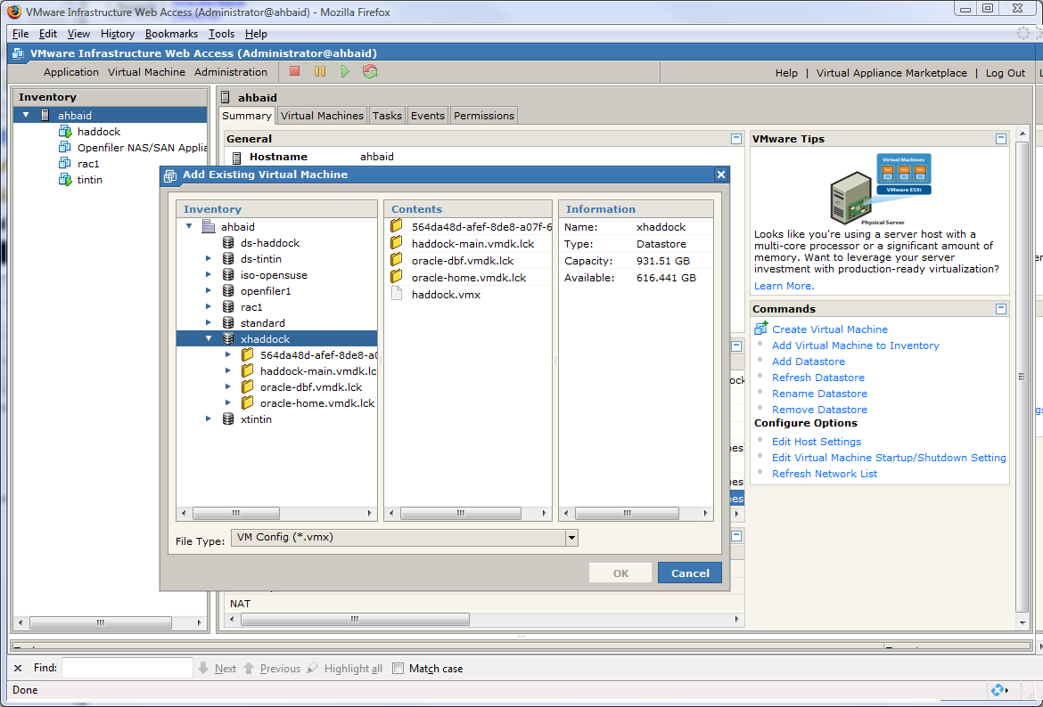
VMware::Vmware 2 Add VM

Slide 10
VMware::Network Setup
WINDOWS hosts file:
c:\windows\system32\drivers\etc\hosts
Linux hosts file:
/etc/hosts
hosts entries:
# Windows Host Entries
127.0.0.1 localhost
::1 localhost
# Linux VM Host (Guest) Entries / Listener fails to start without this entry
127.0.0.1 localhost.localdomain localhost
# Dataguard VMware Configuration on all hosts
192.168.196.1 me me.ahgvm.me
192.168.196.2 tintin tintin.ahgvm.me
192.168.196.3 haddock haddock.ahgvm.me
10.0.0.1 me-pri me-pri.ahgvm.me
10.0.0.2 tintin-pri tintin-pri.ahgvm.me snowy-a snowy-a.ahgvm snowy-a.ahgvm.me
10.0.0.3 haddock-pri haddock-pri.ahgvm.me snowy-b snowy-b.ahgvm snowy-b.ahgvm.me

Slide 11
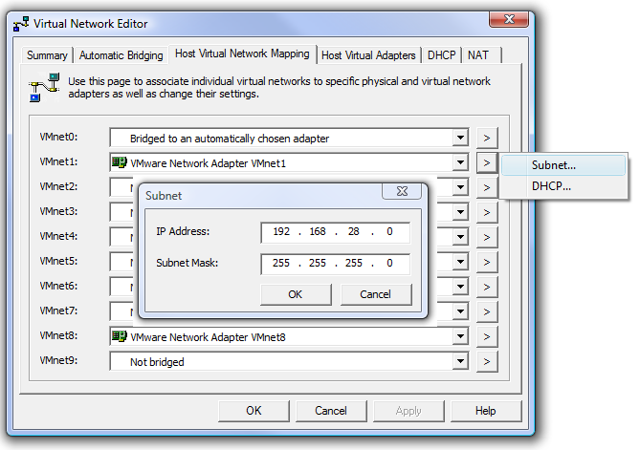
VMware::Network Configuration
VMware 1 & 2 Network Setup:
Start -> Programs -> VMware -> VMware Server -> Manage Virtual Networks:
Virtual Network Editor : Host Virtual Network Mapping
VMnet1 IP/Subnet
192.168.28.0
255.255.255.0
VMnet8 IP/Subnet
192.168.196.0
255.255.25.0

Slide 12
Physical Standby:
DEMO:build standby
Environment
Host tintin snowy-a : db_unique_name: snowy_a
Host haddock snowy-b : db_unique_name: snowy_b
Steps
ALTER DATABASE FORCE LOGGING;
Note Sequence# and SCN as start point
ALTER TABLESPACE tablespace_name BEGIN BACKUP;
Copy tablespace_name datafiles to standby
ALTER TABLESPACE tablespace_name END BACKUP;
ALTER DATABASE CREATE STANDBY CONTROLFILE AS ‘path_to_controlfile’;
Copy init.ora, controlfile and all archivelogs to standby host created since the start point
STARTUP MOUNT #10g
RECOVER STANDBY DATABASE

Slide 13
Physical Standby:
DEMO: file operations
standby_file_management
manual
auto (recommended)
File operations:
Data files
Add, drop, move, resize
Redo log files
standby_file_management=manual
Operate on primary and standby
Standby_file_management=auto
Temporary files
Create temporary files after switchover

Slide 14
Dataguard::Transport
DEMO: TNS setup
Log Transport Mechanisms:
Two Dedicated Listeners (2 ports each)
recommended
Two Dedicated TNS entries (2 ports each)
recommended
log_archive_dest_n
SERVICE
ARCH or LGWR
SYNC, ASYNC=[size]
AFFIRM, NOAFFIRM
log_archive_dest_state_n
enable
defer
reset
alternate
Log Transport Modes:
MAXIMUM PERFORMANCE
Transport: ARCH or LGWR
Transmission: ASYNC if using LGWR
Standby Disk writes: NOAFFIRM
Primary does not stop if standby unavailble
MAXIMUM AVAILABILITY
Transport: LGWR
Transmission: SYNC
Standby Disk writes: AFFIRM (1 standby)
Requires Standby Redo Logs
(online redo group count + 1)*threads
Does not stop if redo not written to >= 1 standby
Downgrades to MAXIMUM PERFORMANCE
MAXIMUM PROTECTION
Transport: LGWR
Transmission: SYNC
Standby Disk Writes: AFFIRM
Requires Standby Redo Logs
(online redo group count + 1)*threads
Hangs if redo not written to >= 1 standby
Waits:
LGWR-LNS wait on channel
enq: CF – contention
ARCH wait for netserver start
Eventual Shutdown
At least two standbys recommended
 | MAX PERF | MAX AVAIL | MAX PROT
REDO | ARCH LGWR | LGWR | LGWR
SYNC | SYNC ASYNC | SYNC | SYNC
WRITE | AFFIRM NOAFFIRM | AFFIRM | AFFIRM
STBY REDO | NO | YES | YES

Slide 15
Dataguard::Transport
DEMO: config
Additional Parameters:
MANDATORY, OPTIONAL
ALTERNATE=[log_archive_dest_n], NOALTERNATE
DEPENDENCY=[log_archive_dest_n], NODEPENDENCY
MAX_FAILURE=[number_of_retries], NOMAX_FAILURE
REOPEN=[seconds] default 60, NOREOPEN
DELAY=[minutes], default 30, NODELAY
NET_TIMEOUT=[seconds], NONET_TIMEOUT
VERIFY, NOVERIFY (with ARCH transport only)
DB_UNIQUE_NAME=[targetdb unique name], NODB_UNIQUE_NAME
VALID_FOR=(redo_log_type, database_role)
redo_log_type: online_logfile, standby_logfile, all_logfiles
database_role: primary_role, standby_role, all_roles
log_archive_config='dg_config=(snowy_a,snowy_b)‘
archive_lag_target=(x+y)
x: current redo log created x seconds ago
y: estimated archival time for current log’s redo
redo log switch when ((x+y) > archive_lag_target) and (redo entries exist))
fal_client
fal_server
Setting Protection Levels:
Add standby redo logs for MAX PROTECTION & MAX AVAILABILITY
STARTUP MOUNT;
ALTER DATABASE SET STANDBY DATABASE TO MAXIMIZE
{PROTECTION | AVAILABILITY | PERFORMANCE};
Open DB

Slide 16
Dataguard::LGWR Transport
Primary Processes
LGWR
LNSn (LGWR Network Server Process)
Standby Processes
RFS (Remote File Server Process)
MRP (Managed Recovery Process)
ARCn
MRP
RFS
DB
r₁
a₁
r₂
LNSn
a₂
DB
r₃
ARCn
LGWR
r₁
a₁
Standby Redo logs
a₃
r₂
a₂
Archive Logs
STANDBY DB
r₃
ARCn
a₃
Redo logs
Archive Logs
PRIMARY DB
DEMO: max prot & max avail

Slide 17
Dataguard::Monitoring
Primary V$VIEWS
V$DATABASE
V$ARCHIVE_DEST
V$ARCHIVE_LOG
V$LOGFILE
V$DATAGUARD_STATUS
Standby V$VIEWS
V$DATABASE
V$ARCHIVED_LOG
V$LOG_HISTORY
V$MANAGED_STANDBY
GAP/LAG Detection

Slide 18
Dataguard::Production
Upgrades
Install new ORACLE_HOME on Primary and Standby
Stop Standby after all logs applied
Upgrade Primary from new ORACLE_HOME
Start Standby from new ORACLE_HOME applying all logs
Cloning
Create a standby
Activate
nid to change DBID and DBNAME
RMAN deletes
Archive backup on primary and delete
MAX AVAILABILITY and less affected

Slide 19
Dataguard::Tuning
Primary
Better SQL
Code reviews
parallel_execution_message_size = 4096
disk_async_io = true
Standby
Increase DB writers
Decrease unused pools
Java Pool
Streams Pool
Increase MRP parallelism
parallel_max_servers = 2 x cpu count
db_block_checking = false
parallel_execution_message_size = 4096
disk_async_io = true
Dedicated network for DG traffic

Slide 20
References
Oracle Documentation:
http://tahiti.oracle.com
Dataguard Concepts and Administration
Books:
Oracle Database High Availability with RAC, Flashback & Data Guard – Matthew Hart & Scott Jesse, Oracle Press
Oracle Data Guard – Bipul Kumar, Rampant
Oracle on VMware – Bert Scalzo, Rampant
Sites:
otn.oracle.com
ocpdba.net
orafaq.com
psoug.org
vmware.com
Mailing Lists:
Oracle-L

Slide 21
Thank You Ahbaid Gaffoor ahbaid@{amazon.com|a9.com|att.net}

